Slide 1
TWITTER BASED SENTIMENT ANALYSIS
Team members:
1.Atchaya.S
2.Anitha Rajam.M
3.Dheekshitha.D
Industry Mentor:
Mrs. Yukthika
Faculty Guide:
Mrs. Suganthi
Department of CSE, KGiSL Institute of Technology, Coimbatore

Slide 2
Abstract
This project addresses the problem of sentiment analysis in twitter, that is classifying tweets according to the sentiment expressed in them. Due to large amount of usage we hope to achieve a reflection of public sentiment by analyzing the sentiments expressed in the tweets. Analyzing the public sentiment is important for many applications such as firms trying to find out the response of their products in the market. The aim of this project is to develop a functional classifier for accurate and automatic sentiment classification of an unknown tweet stream.
Department of CSE, KGiSL Institute of Technology, Coimbatore

Slide 3
Area Introduction-Existing system
The Existing work mainly focuses on classifying user into binary sentiment(i.e positive, negative) and they do not go further in mining user sentiment.
The Existing approaches mainly leverage product category information or tag information to study the interpersonal influence.
User reviews can provide us ideas in mining interpersonal interference and user preferences.
Department of CSE, KGiSL Institute of Technology, Coimbatore

Slide 4
Proposed System
Advantages
Proposed system will gives you the freedom to choose the data of any topic.
It gives you the impact the results and statistics will have on the respective field.
Proposed system allows retrieval of data based on the query entered by the user.
Proposed system will provide accurate feature selection.
Department of CSE, KGiSL Institute of Technology, Coimbatore

Slide 5
Literature Review
Existing system takes a stored dataset a particular topic into consideration.
It fails to determine the impact the results might or will have in the respective field.
Existing system does not allow the retrieval of data based on the query entered by user.
Accurate feature selection will not be provided.
Department of CSE, KGiSL Institute of Technology, Coimbatore

Slide 6
DATA FLOW DIAGRAM
TWITTER DATA
Datasets
Words Classification
NLTK with Naïve Bayes algorithm
Support vector algorithm
Result of Statistical Representation

Slide 7
Python Packages Used for Twitter Analysis
Tweepy: It is an open-sourced and enables Python to communicate with Twitter platform and use its API.
Mainly used for processing the datas.
Text Blob: Processing textual data. It is used to process the twitter data in python packets.
NLTK: Data understanding. It is used to understand the language used in data.
These three tools are mandatory.
Hence by using these tools we bring the datas inside the python by tweepy, then we segregate the words by using text blob then by using NLTK we understand the meaning of the data.

Slide 8
Module Split-up
Module 1:
Datasets
Module 2:
Data Cleaning
Module 3:
Naive Bayes Algorithm
Module 4:
Support Vector Algorithm
Module 5:
Prediction and Accuracy

Slide 9
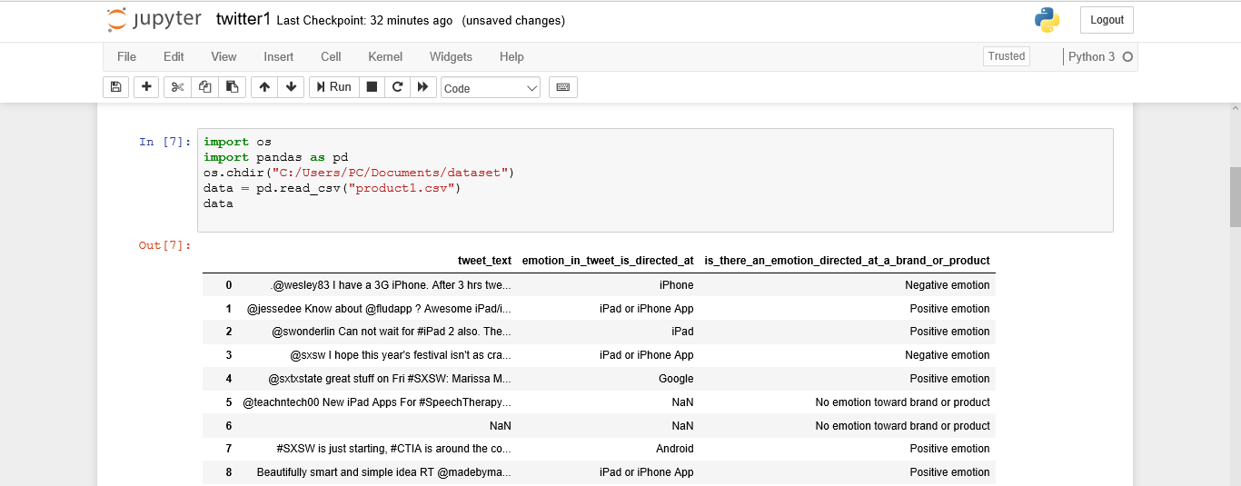
Screen shots of module under progress

Slide 10
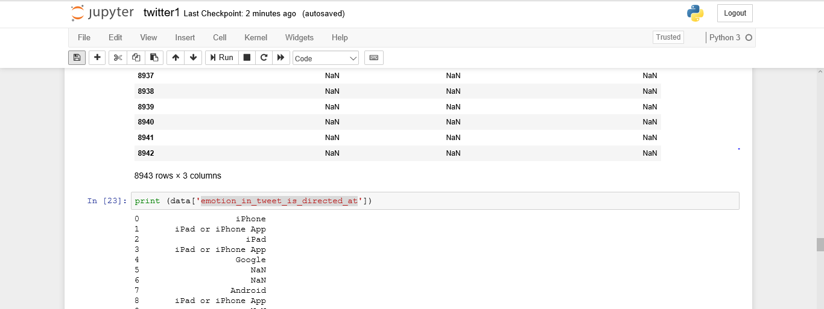
Cntd…

Slide 11
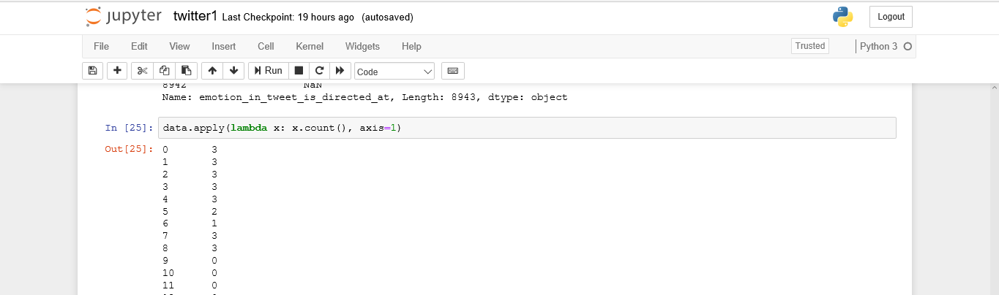
Cntd…

Slide 12
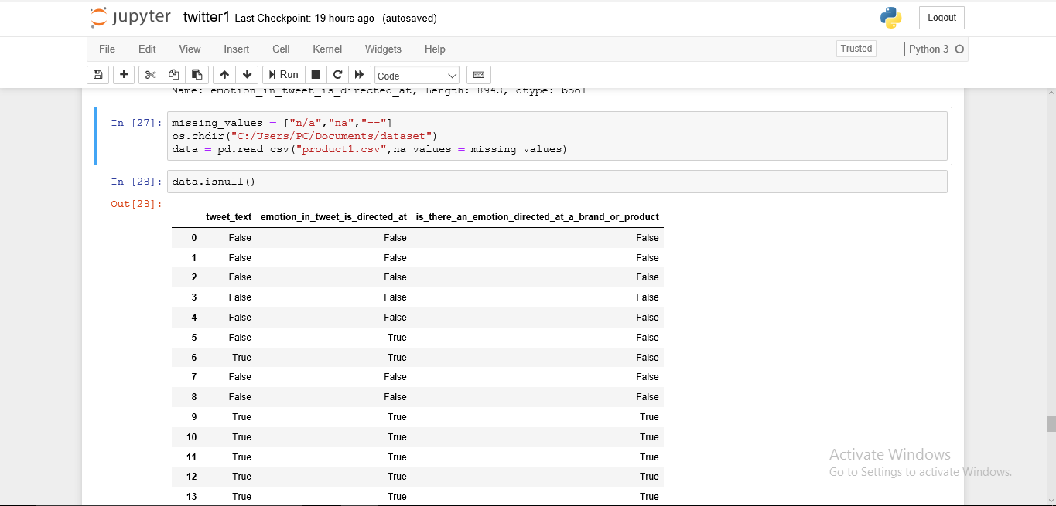
Cntd…

Slide 13
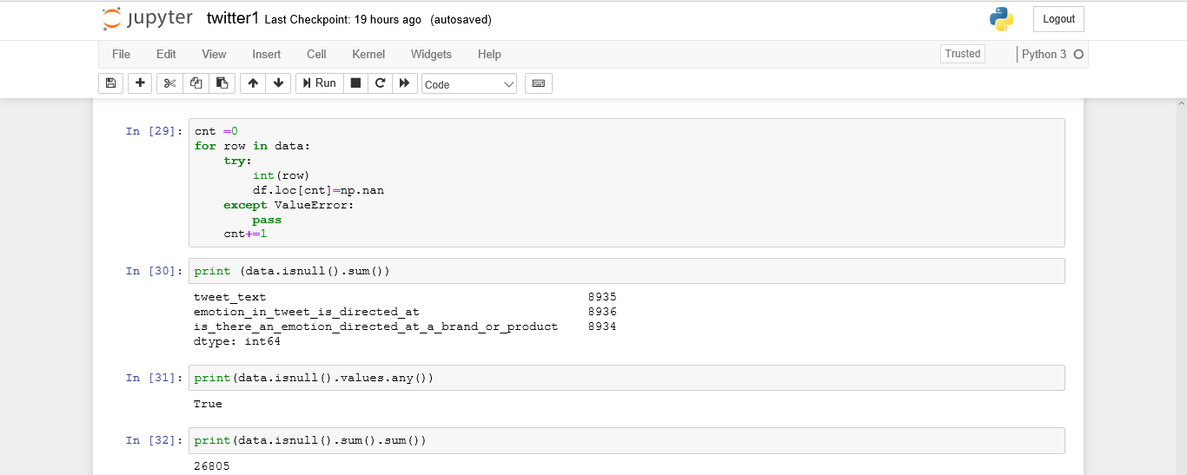
Cntd…

Slide 14
Naïve Baye’s Algorithm
In machine learning, Naive Bayes classifiers are a family of simple "probabilistic classifiers" based on applying Bayes' theorem with strong (naive) independence assumptions between the features.
P(h|d) = (P(d|h) * P(h)) / P(d)

Slide 15
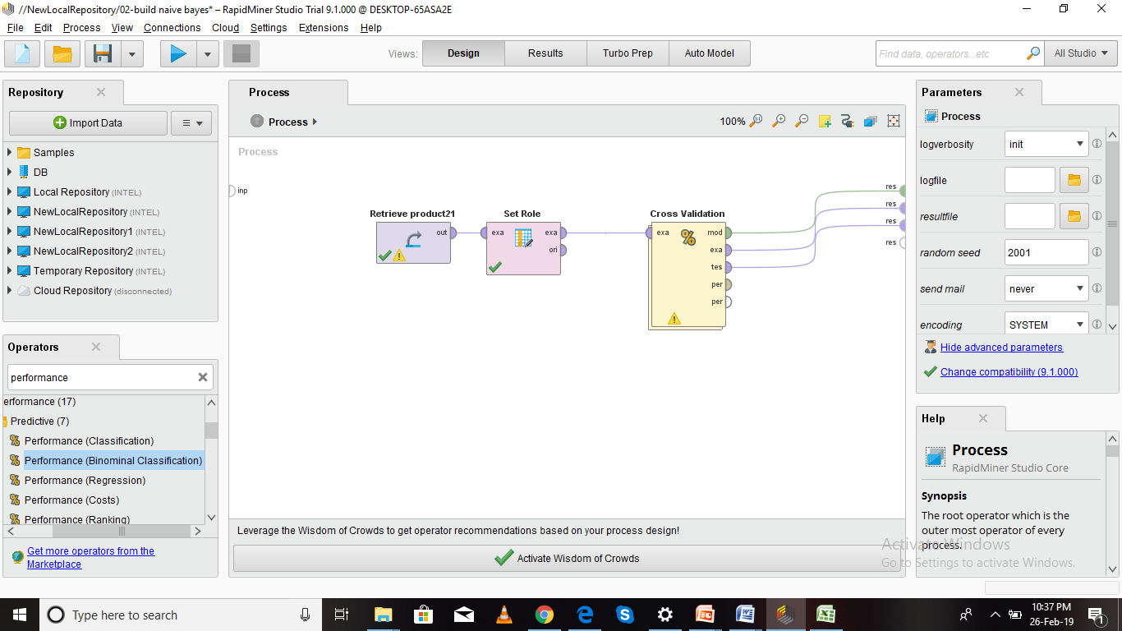
Screenshots

Slide 16
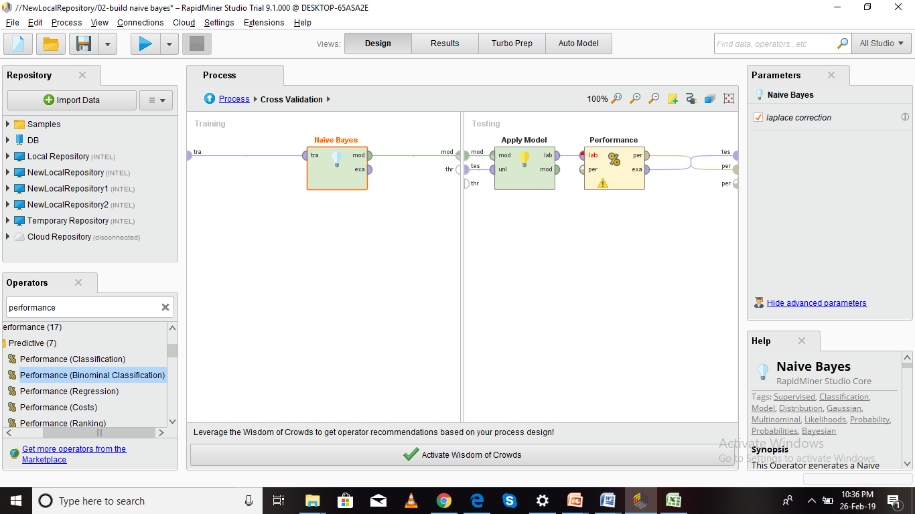
Cntd..

Slide 17
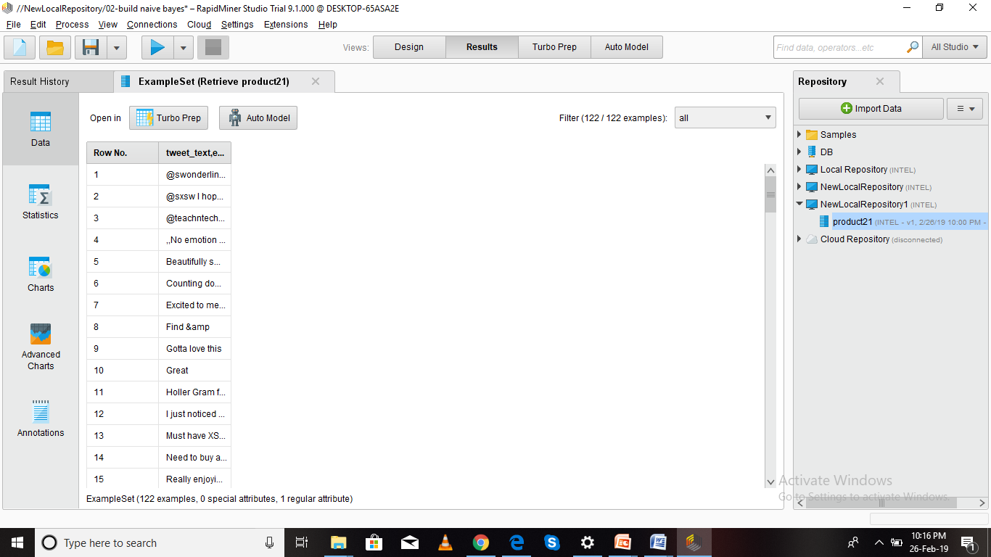
Cntd..

Slide 18
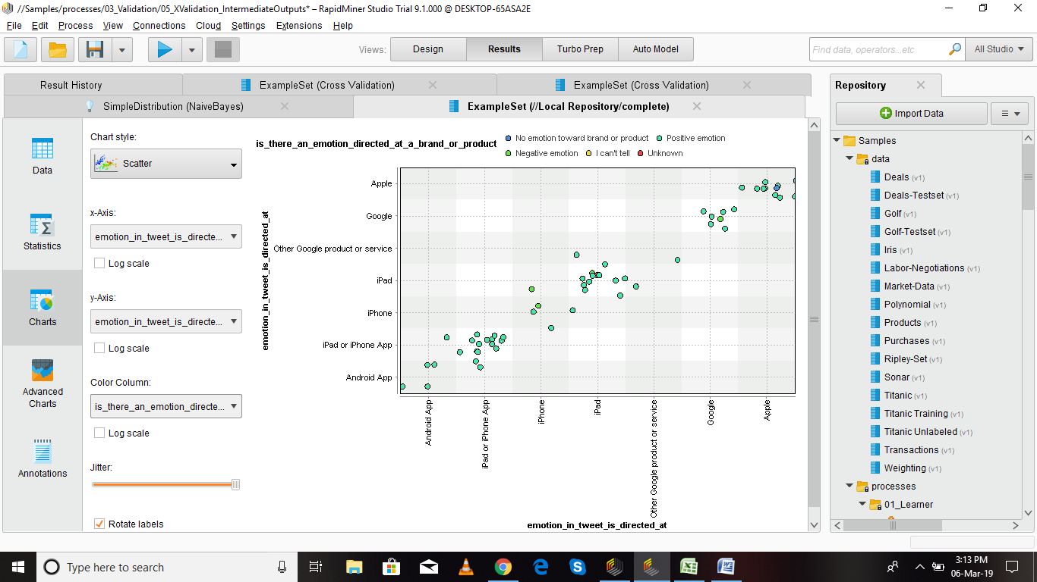
Cntd..

Slide 19
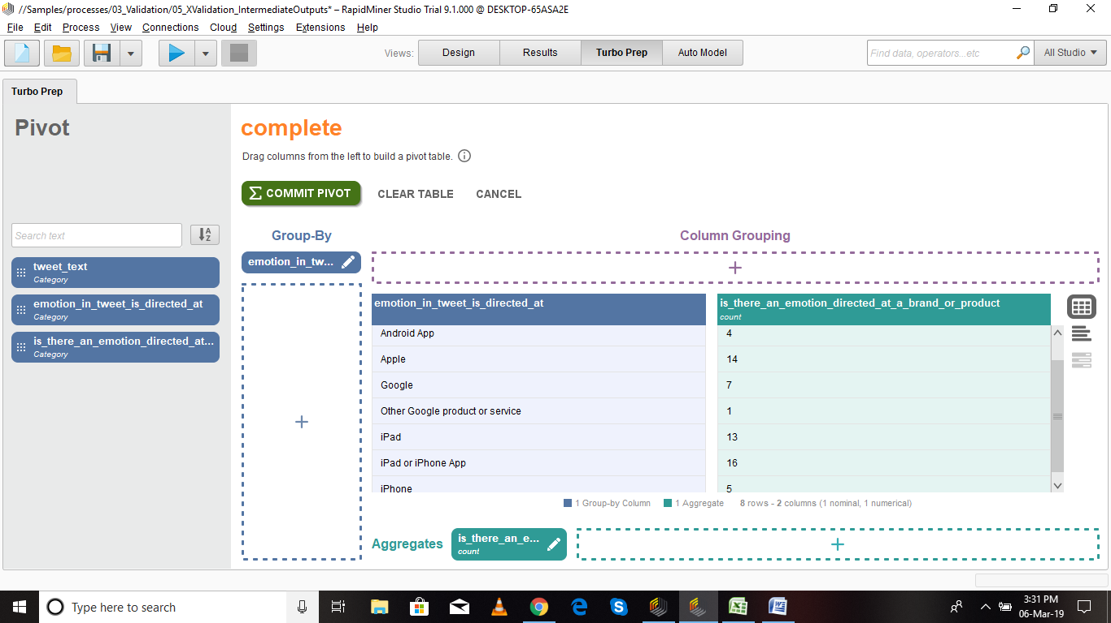
Cntd…

Slide 20
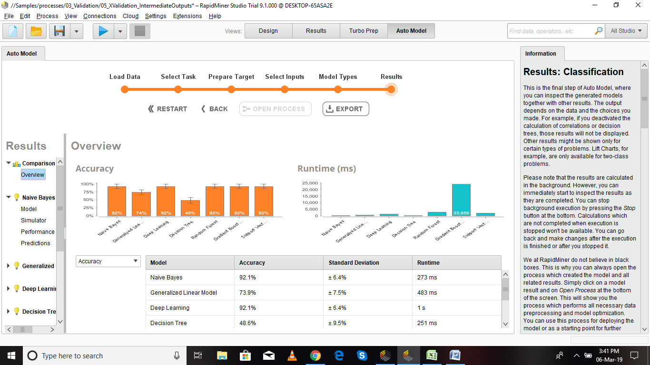
Cntd…

Slide 21
Support Vector Algorithm
Support vector machine (SVM) solves the traditional text categorization problem effectively; generally outperforming Naïve Bayes as it supports the concept of maximum margin.
The idea of SVM is to determine a boundary or boundaries that separate distinct clusters or groups of data. SVM performs this task constructing a set of points and separating those points using mathematical formulas.

Slide 22
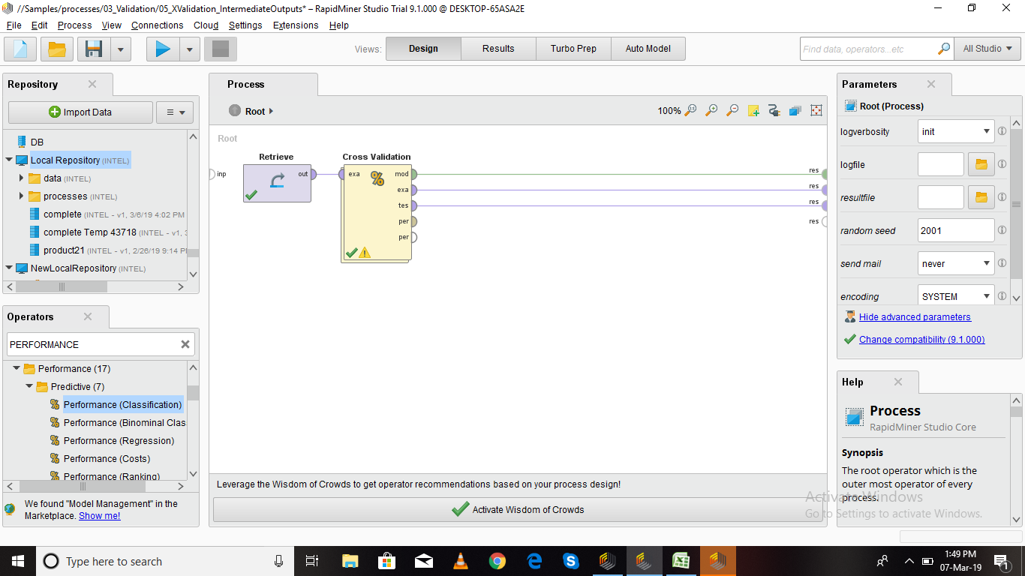
Cntd…

Slide 23
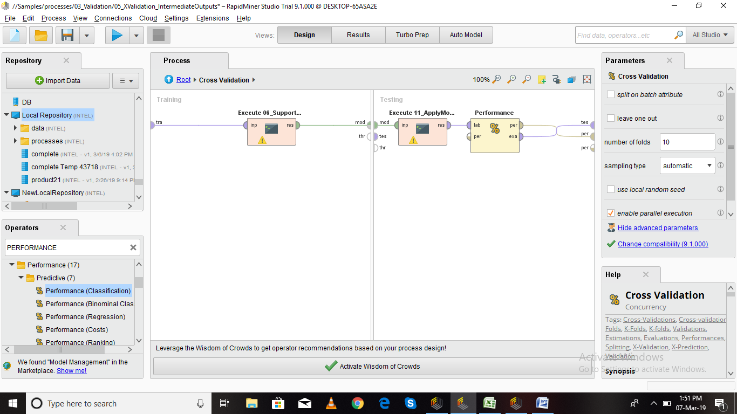
Cntd…

Slide 24
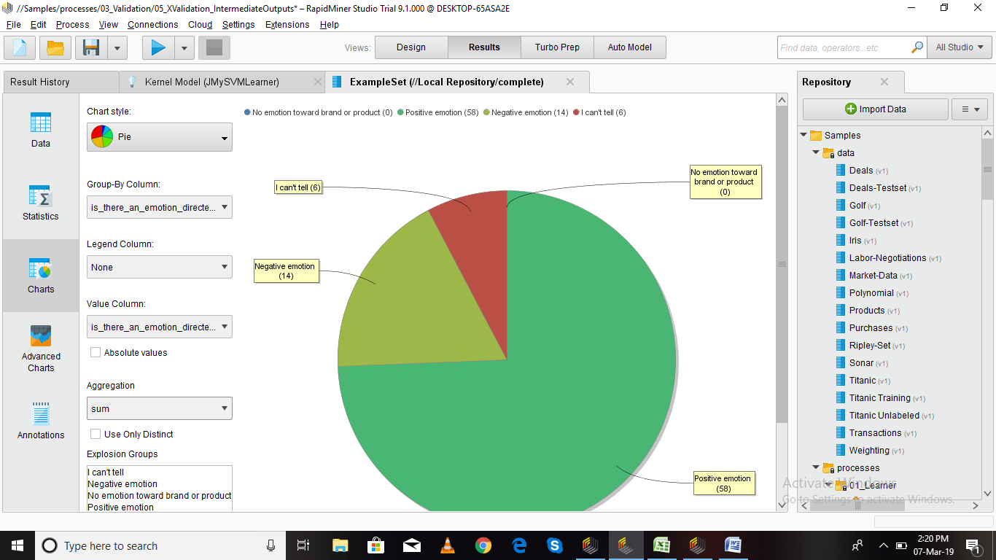
Cntd…

Slide 25
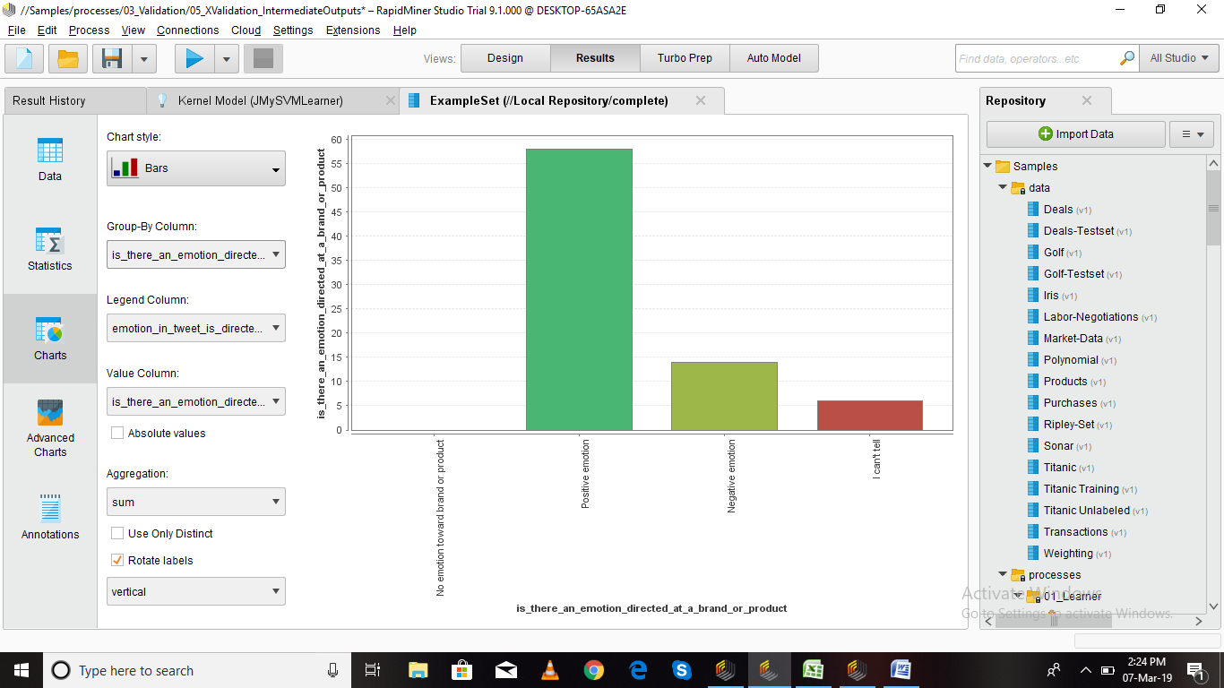
Cntd..

Slide 26
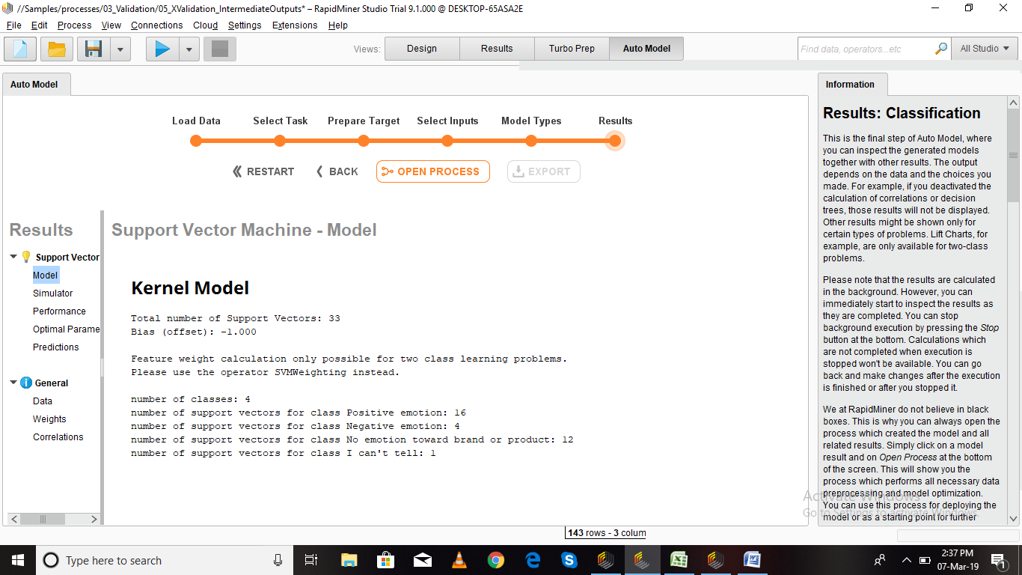
Cntd..

Slide 27
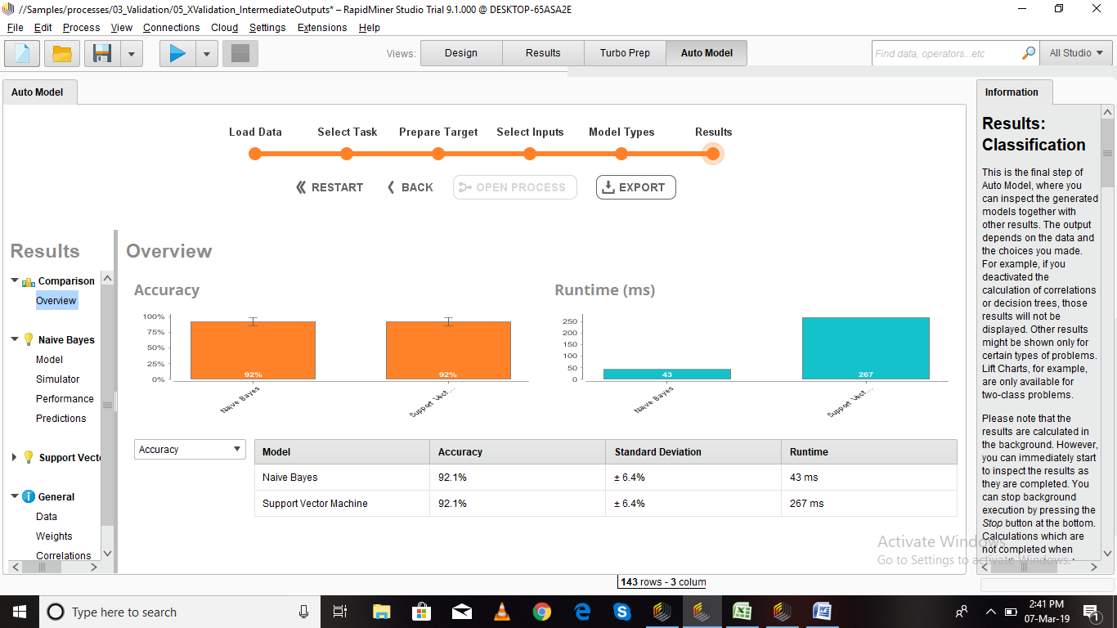
Cntd..

Slide 28
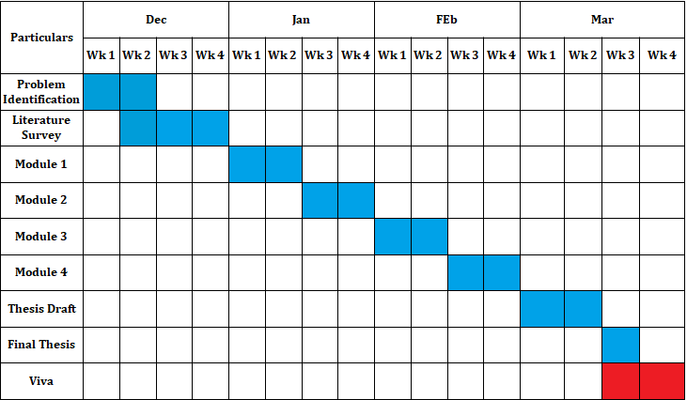
Project Planner / Timeline chart)
Department of CSE, KGiSL Institute of Technology, Coimbatore

Slide 29
THANK YOU

